Slide 1
Analyzing
World’s Covid-19 to predict Korea’s Covid-19 trends
컴퓨터정보통신공학과 B789011 김성훈
컴퓨터정보통신공학과 B789029 성정현
글로벌경영학과 B393042 박장호

Slide 2

01.
ML problem definition
Dataset : World Covid-19 current situation
Corona-19 vaccinations in the United States began on December 14, 2020.
We wanted to predict Covid-19 infections trends through the various features, not only investigating directly.
Through this analysis, the final goal is to predict what will happen since Korea's Covid-19 trends.

Slide 3

02.
Data set selection
Columns : 70
Values : 120,556
Countries : 244

Slide 4
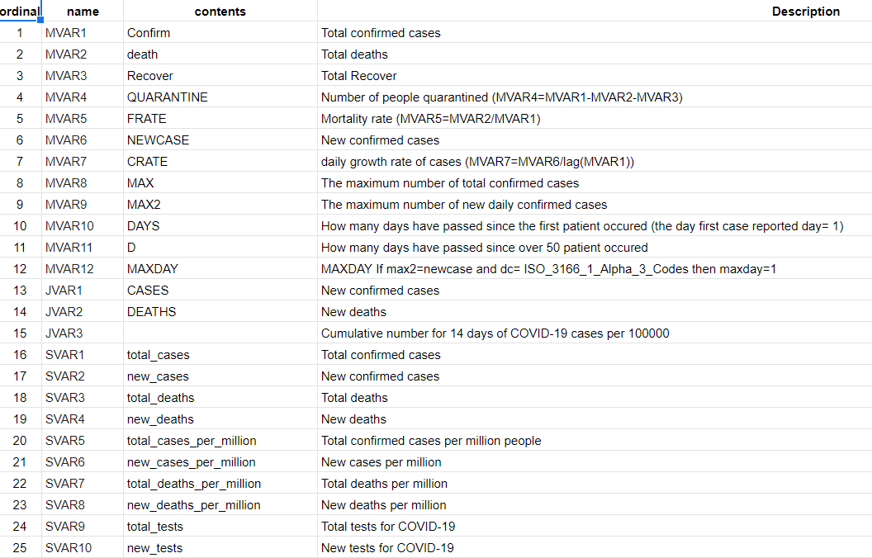
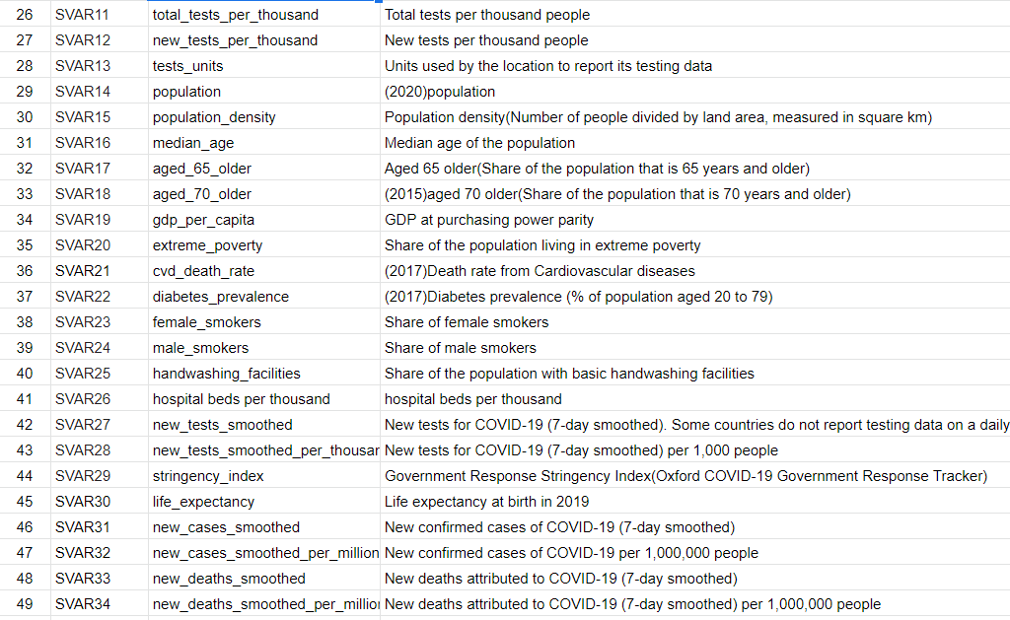
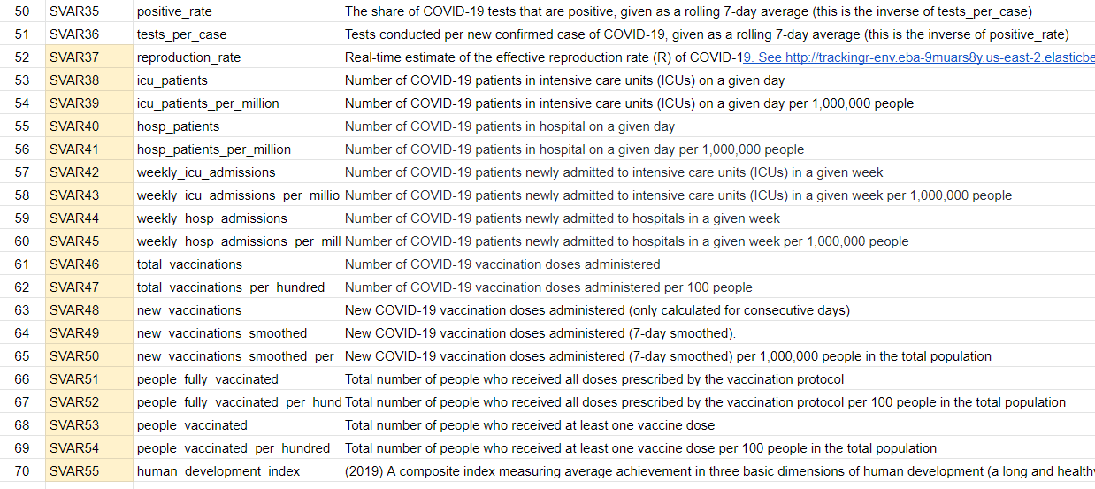
02.
Data set selection
https://sites.google.com/view/snuaric/covid-19/covid-19-data

Slide 5
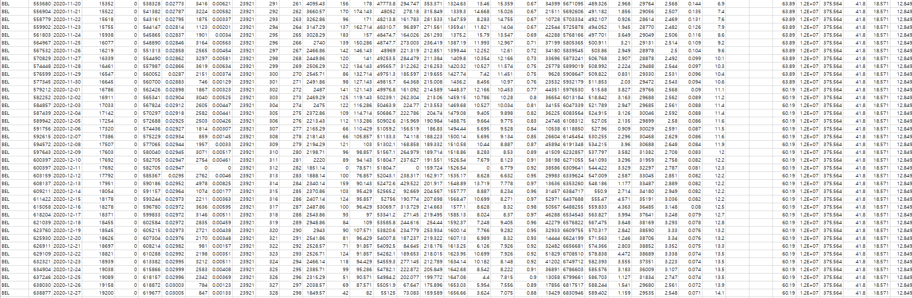
02.
Data set selection

Slide 6
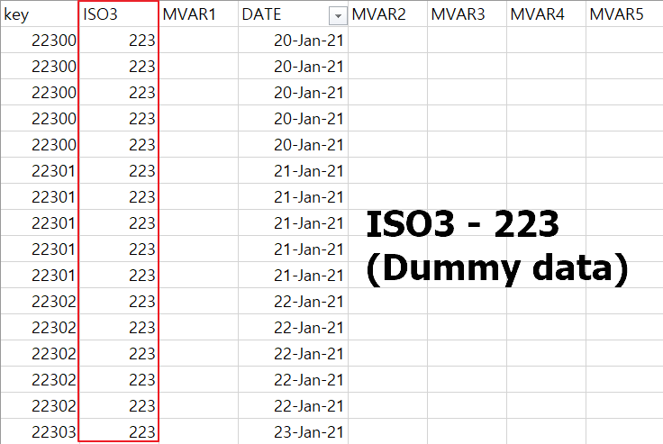
03.
Data preprocessing

Slide 7
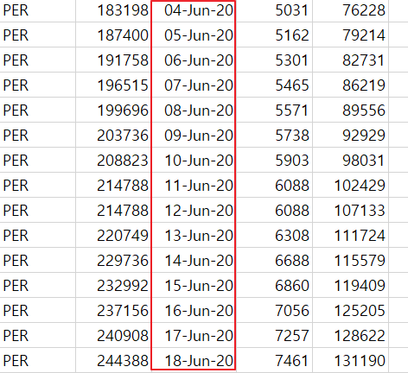
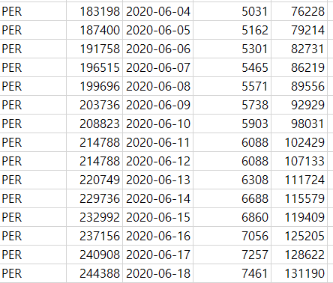
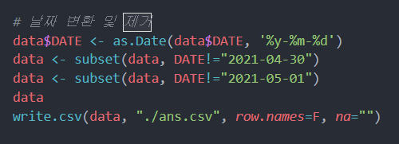
03.
Data preprocessing
Convert String
to Date data

Slide 8
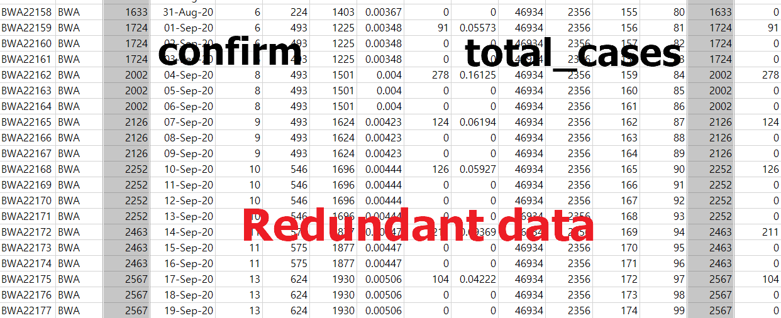
03.
Data preprocessing

Slide 9
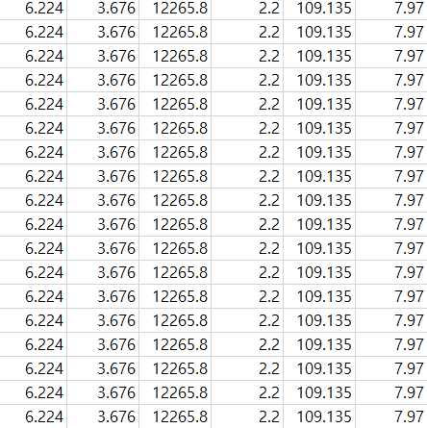
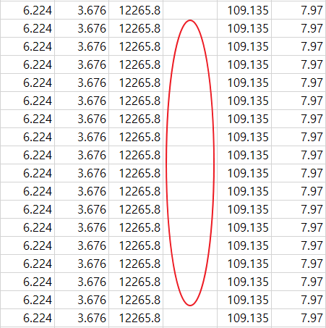
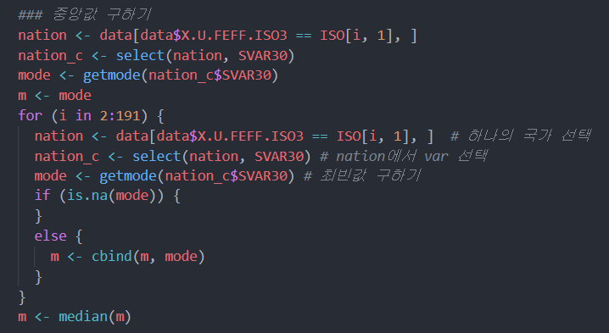
03.
Data preprocessing

Slide 10
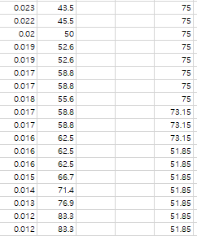
03.
Data preprocessing
Too many missing values
Delete
COLUMN!

Slide 11
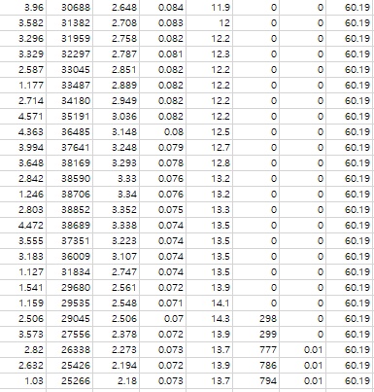
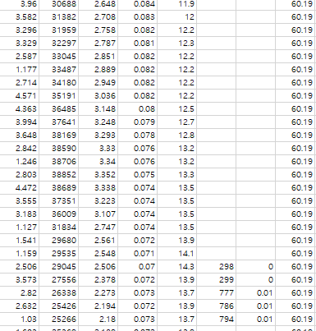
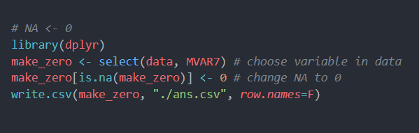
03.
Data preprocessing
Starting point,
zero datas are in NA

Slide 12
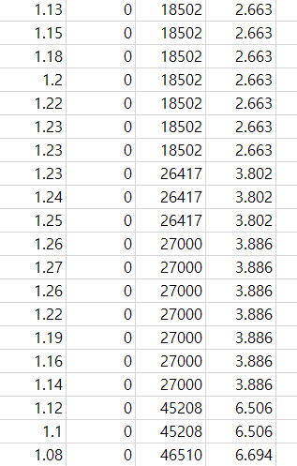
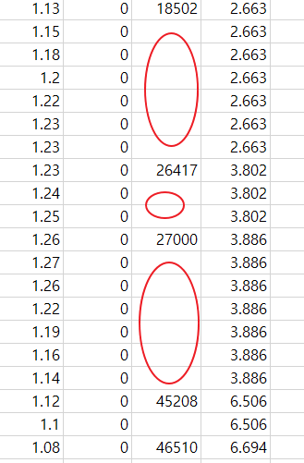
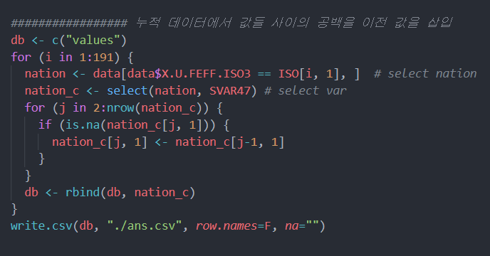
03.
Data preprocessing

Slide 13
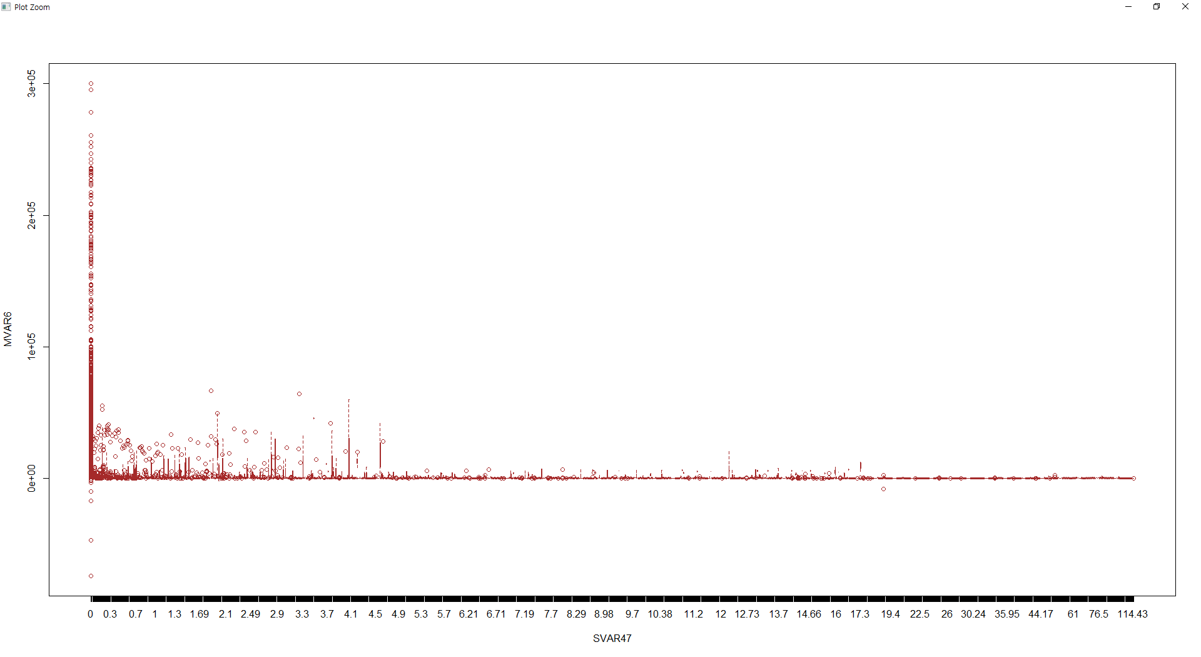
03.
Data preprocessing
Deleting outliers

Slide 14
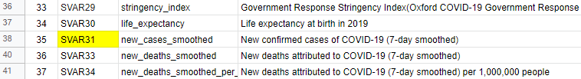
03.
Data preprocessing
Deleting other Y variable

Slide 15
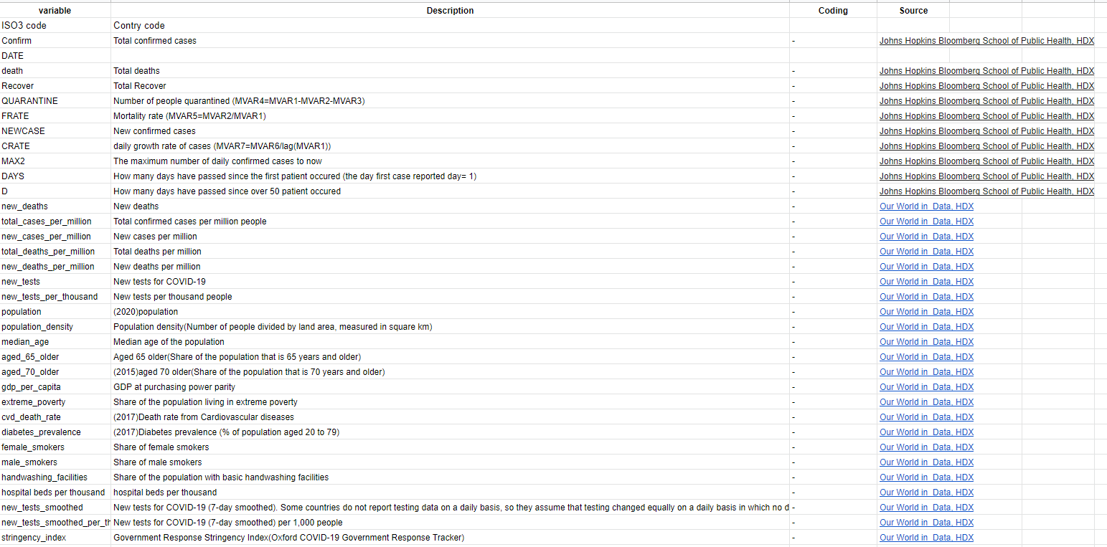
03.
Data preprocessing

Slide 16
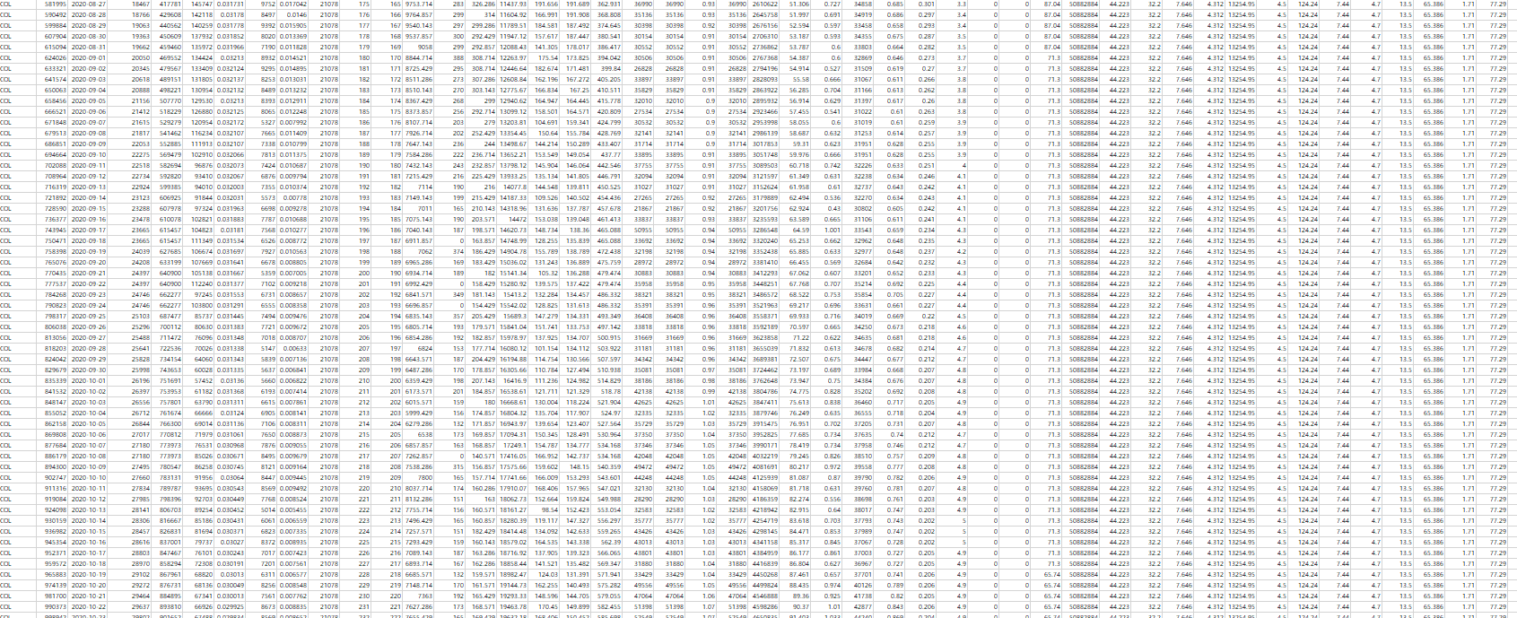
03.
Data preprocessing
Columns : 70
Values : 120,556
Countries : 244
Columns : 47
Values : 91,236
Countries : 190

Slide 17
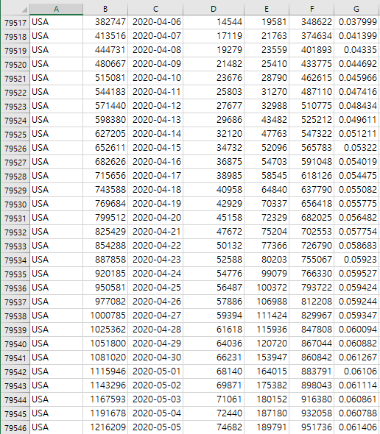
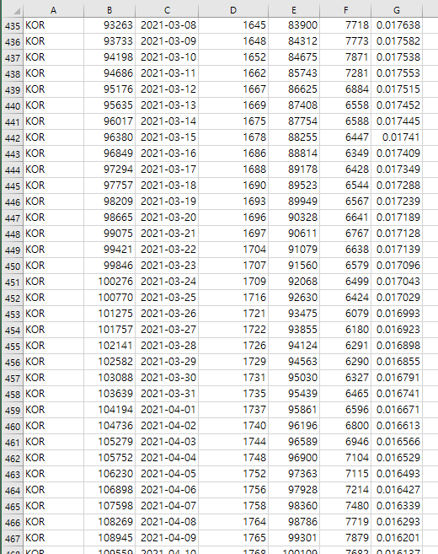
03.
Data preprocessing
Our target : Expecting Korea’s COVID-19 cases trends (new_cases)
train_data
Columns : 44
Rows : 91,236
Contries : 190 (~ 21.3.26)
test_data
Columns : 44
Rows : 500 (0.61%)
Contry : Korea
(~ 21.5.13)

Slide 18
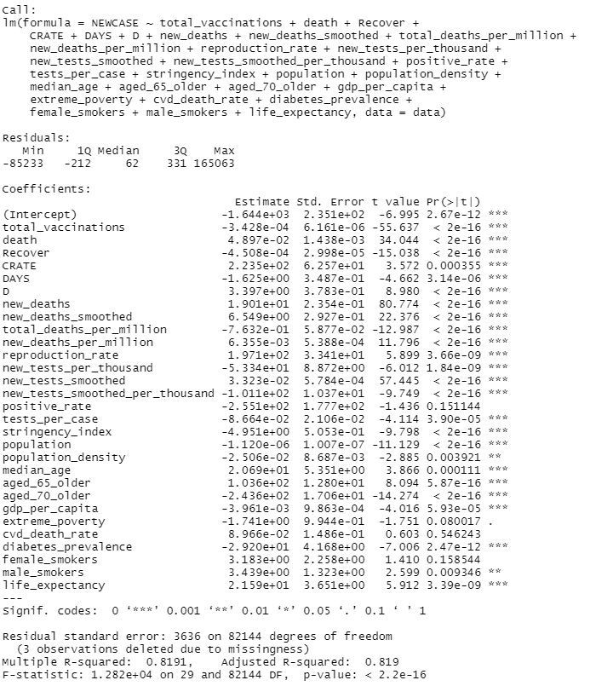
03.
Data preprocessing
There were factors with
Shallow, or bad effects
◎ positive_rate
◎ extreme_poverty
◎ cvd_death_rate
◎ female_smokers
They are alomost all constant values

Slide 19


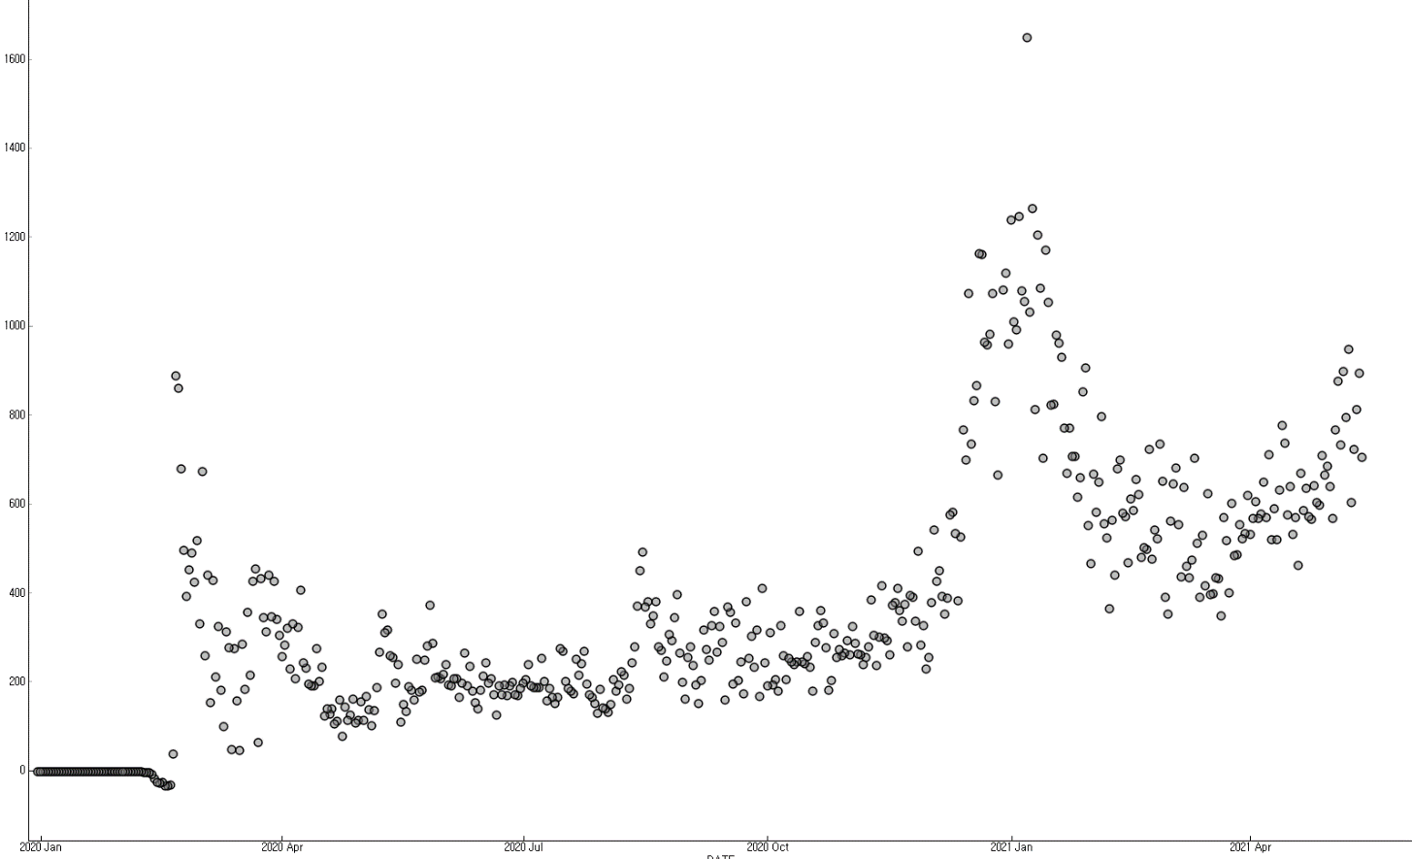
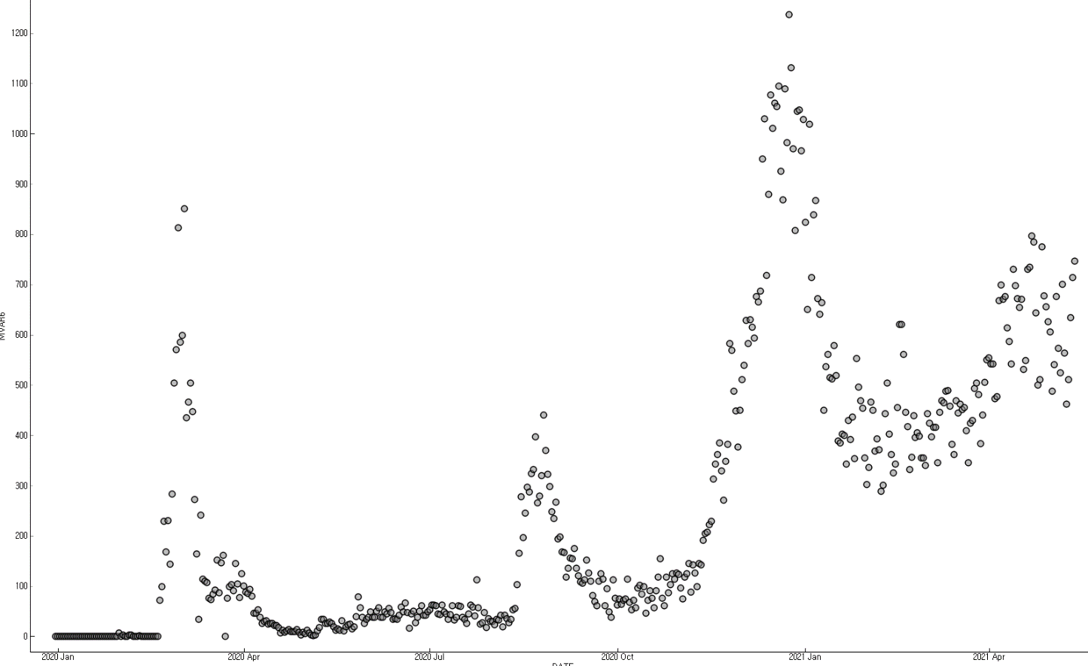
04.
Base line Algorithm performance
Cross-validation (10-fold)
Test error
Linear regression
Scatter plot from Linear regression (Korea)
Real data (Korea)

Slide 20
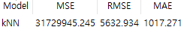
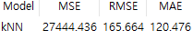
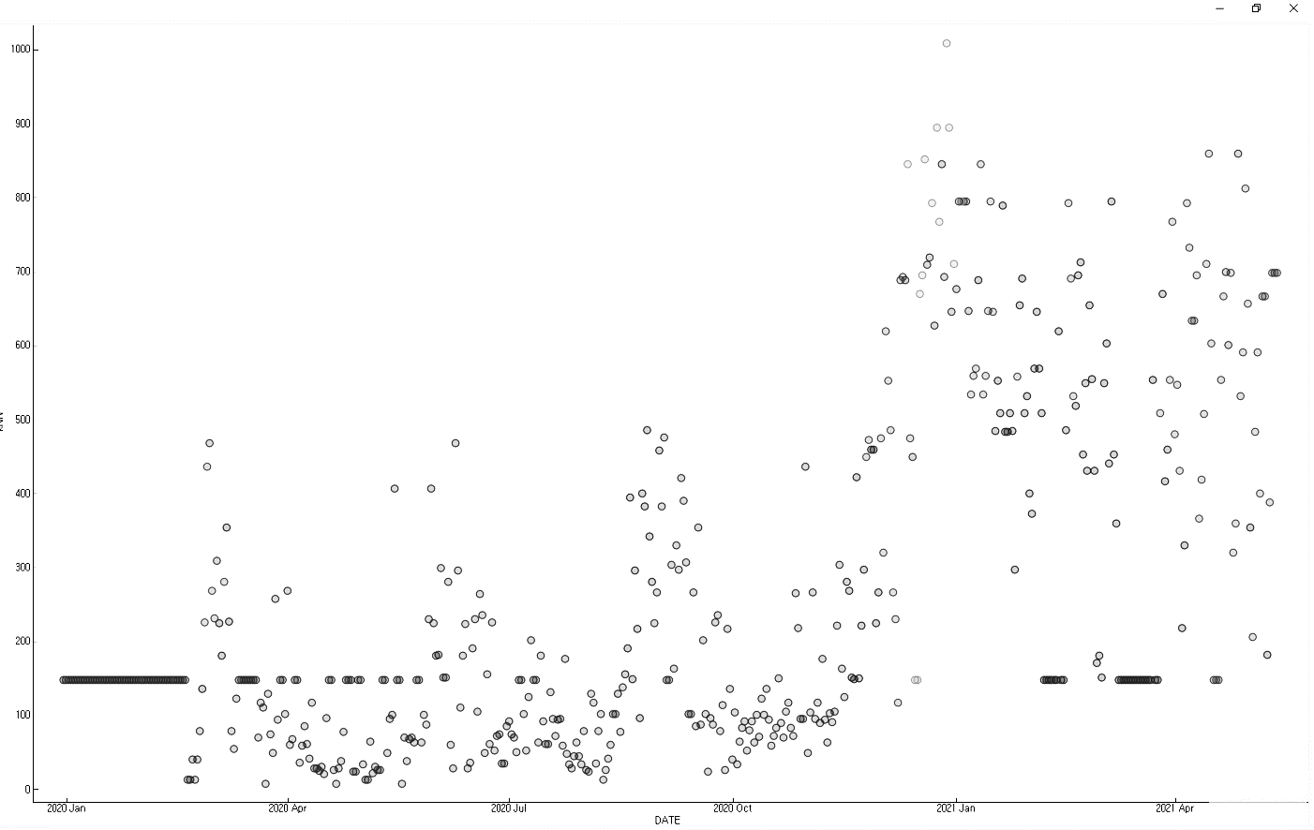
05.
Comparing other Algorithms
Cross-validation (10-fold)
Test error
KNN (K=3)
Scatter plot from Linear regression (Korea)
Scatter plot from KNN (Korea)

Slide 21
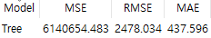
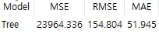
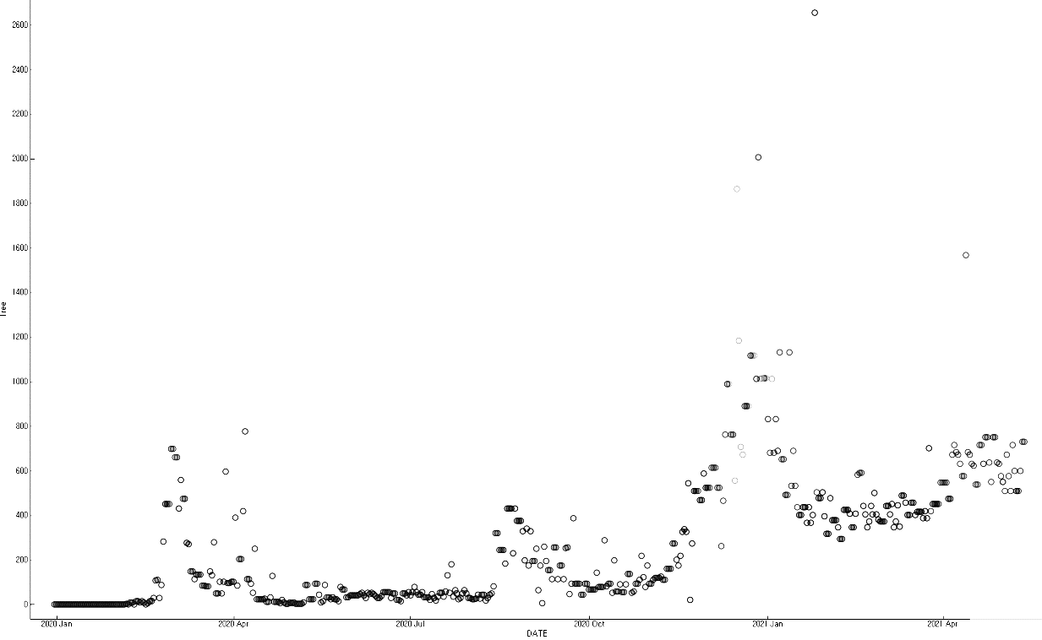
05.
Comparing other Algorithms
Cross-validation (10-fold)
Test error
Tree
Scatter plot from Linear regression (Korea)
Scatter plot from Random forest (Korea)

Slide 22
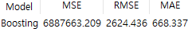
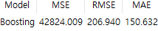
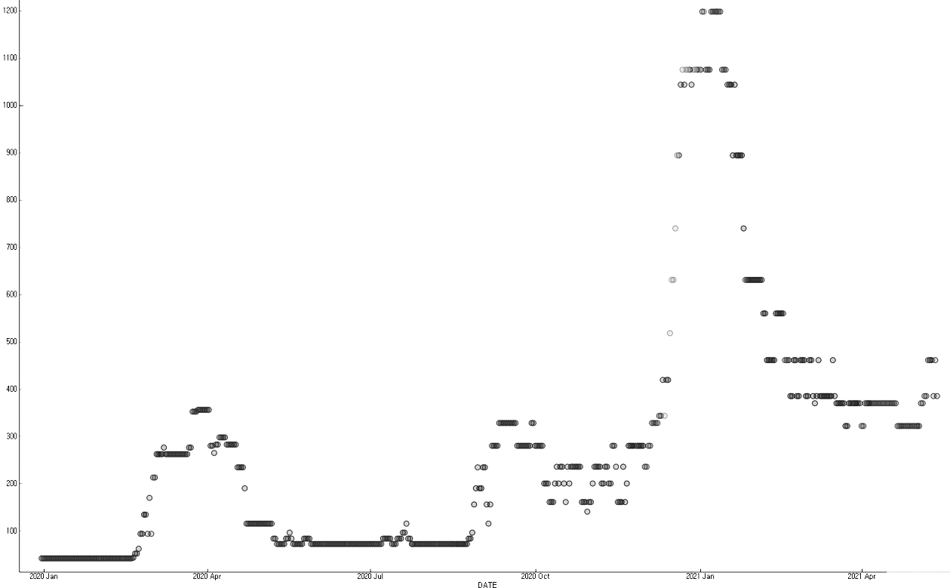
05.
Comparing other Algorithms
Cross-validation (10-fold)
Test error
Boosting
Scatter plot from Linear regression (Korea)
Scatter plot from Boosting (Korea)

Slide 23
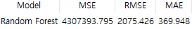
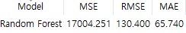
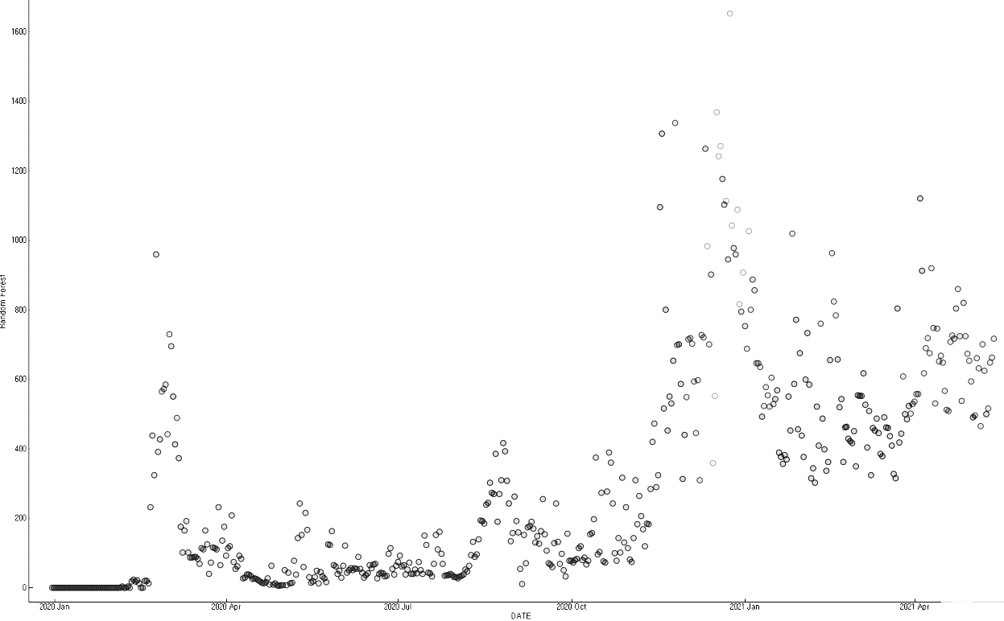
05.
Comparing other Algorithms
Cross-validation (10-fold)
Test error
Random forest
Scatter plot from Linear regression (Korea)
Scatter plot from Random forest (Korea)

Slide 24
05.
Comparing other Algorithms
Cross-validation (10-fold)
Test error
Linear regression
KNN (K=3)
Tree
Boosting
Random forest

Slide 25
05.
Comparing other Algorithms
Cross-validation (10-fold)
Test error
Real data - Tree
Real data (Korea)
Scatter plot from Random forest (Korea)

Slide 26
Thank you

